Slide 1

BC Code Reviewer – Final Presentation
Christina Nguyen
Michael Bloomquist
Sarah Ramazani
Travis Lamb

Slide 2
References
PR/FAQs
Software Requirements Specification (SRS)
Software Design Document (SDD)
Testing Log

Slide 3
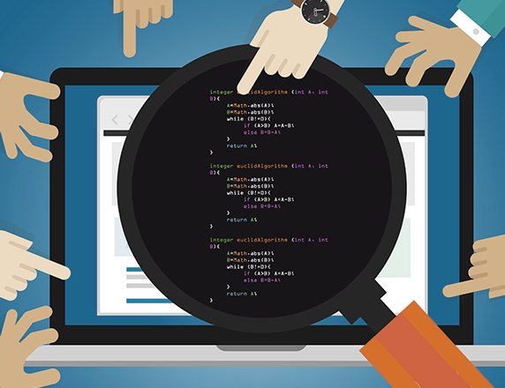
Introduction
Code Review is the systematic examination of the source code.
Limits risks
Improves code quality
Makes everyone better
Helps users be familiar with the project

Slide 4

DESCRIPTION OF THE PROJECT
Git Going is integrated with Git, which is a distributed VCS
Collaboration
Peer Review

Slide 5
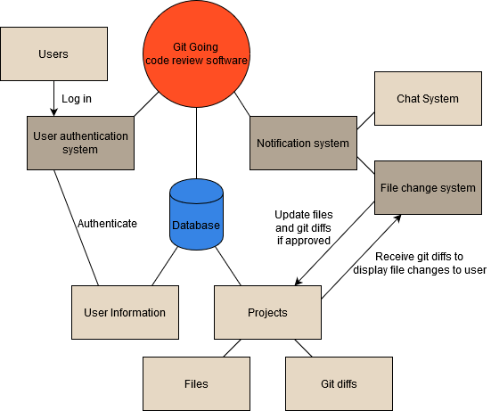
USER functional REQUIREMENTS
Registration
Login
Logout
Account Setting
File Change System
Chat System
Notification System

Slide 6
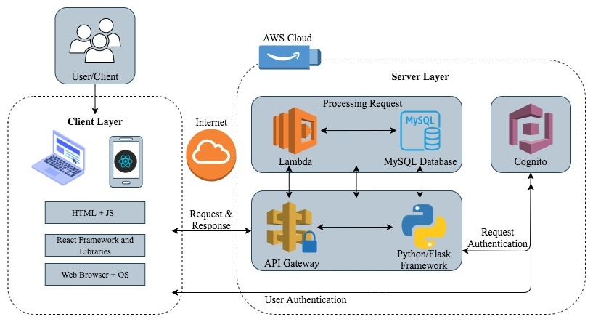
Architectural design
Client-Server pattern
Client layer: HTML, JS, React Frameworks etc.
Server layer: AWS cloud, API gateway.
Processing Request: Lambda and a MySQL database
Output: PC, smartphone, or laptop.

Slide 7

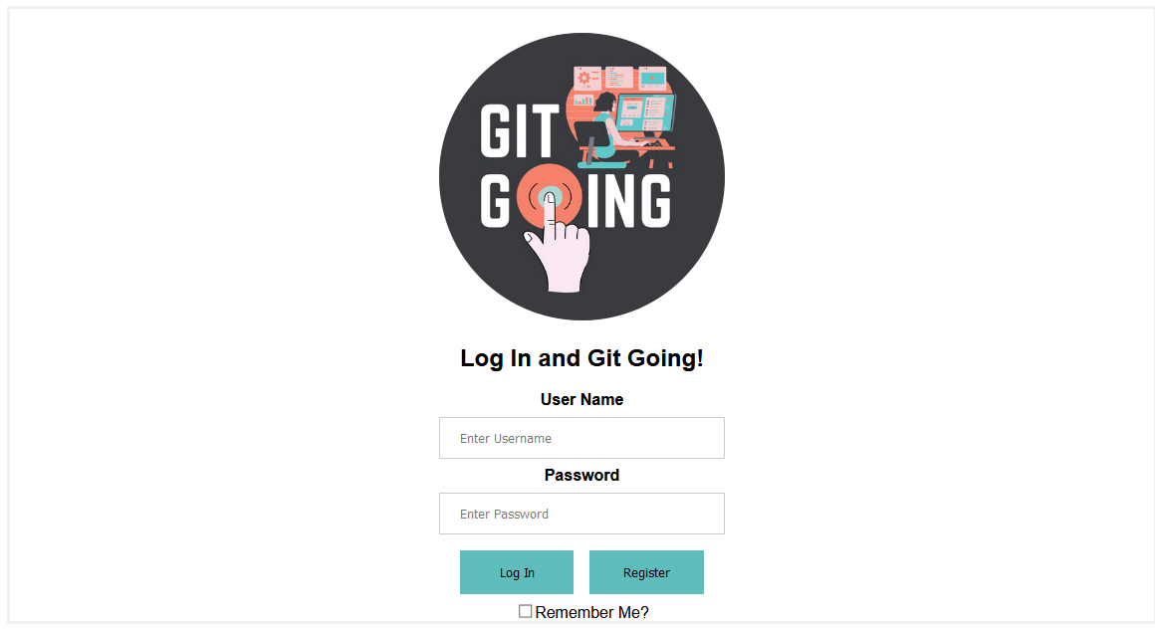
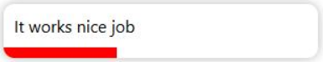
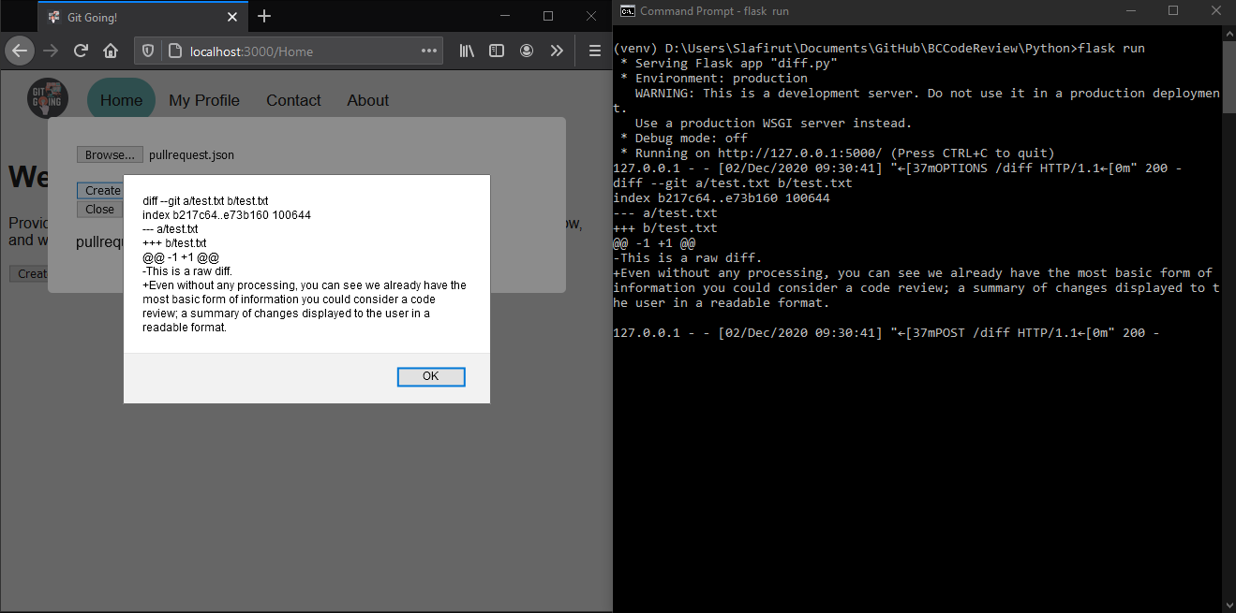
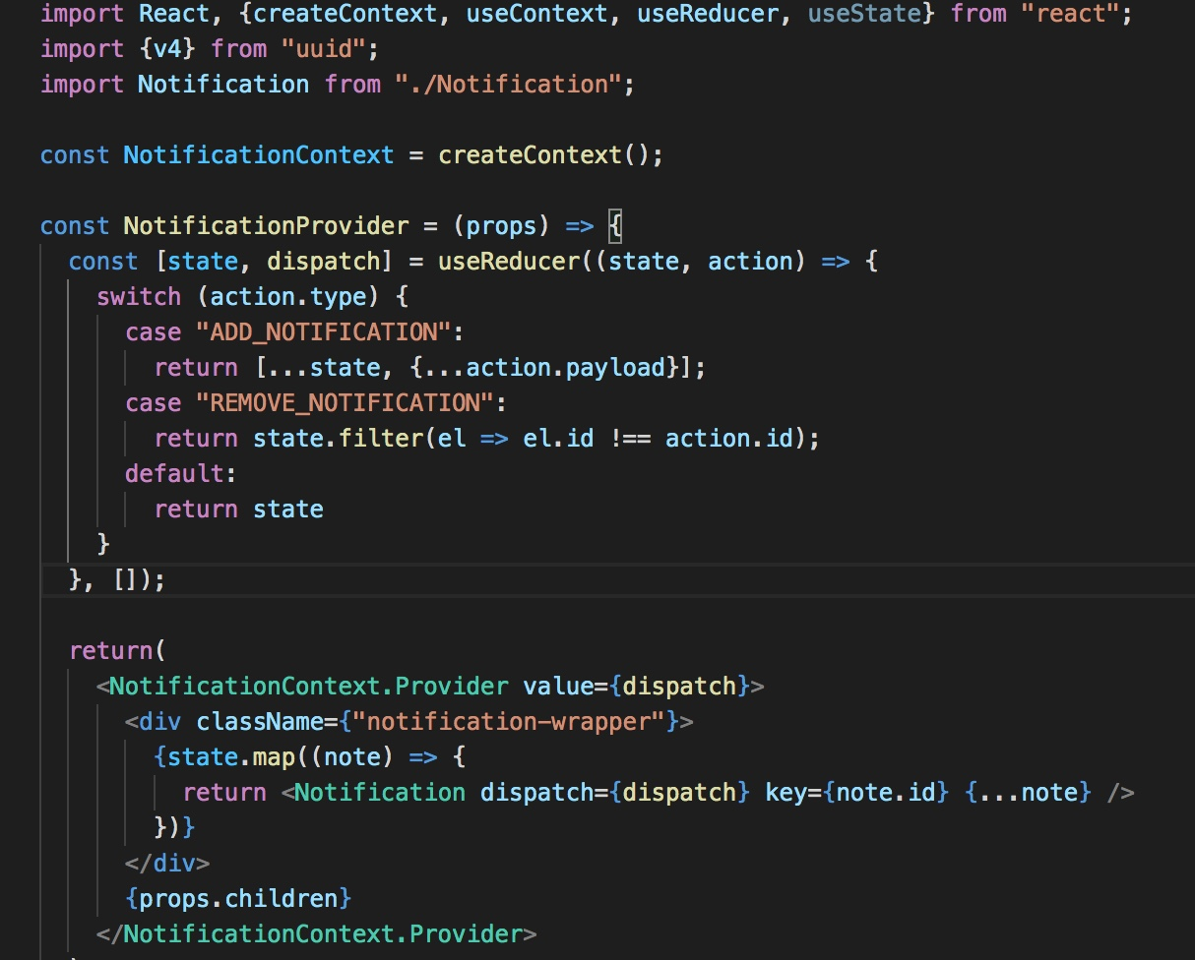
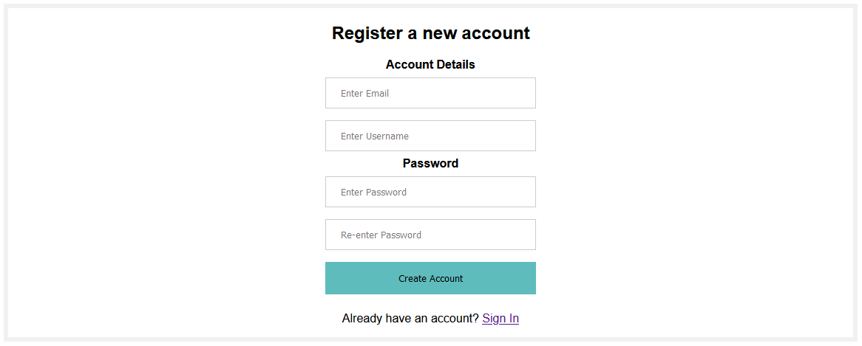
Our biggest coding achievements
Partially functioning login system
Notification System
Functioning registration system which pushes new user information into a hosted database with a POST request
Diff retrieval from a remote directory with a POST request

Slide 8
Our biggest coding achievements
Partially functioning login system
Notification System
Functioning registration system which pushes new user information into a hosted database with a POST request
Diff retrieval from a remote directory with a POST request

Slide 9
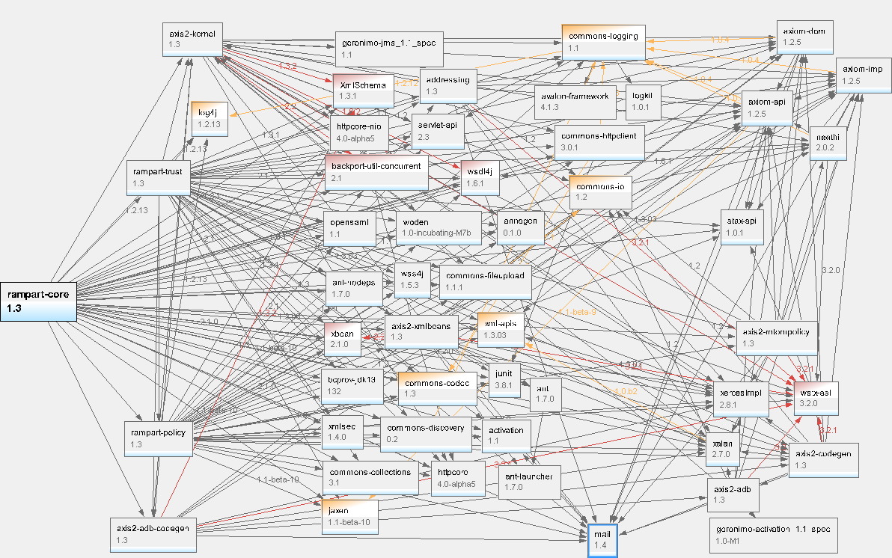
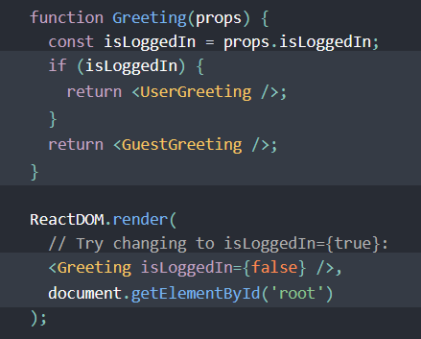
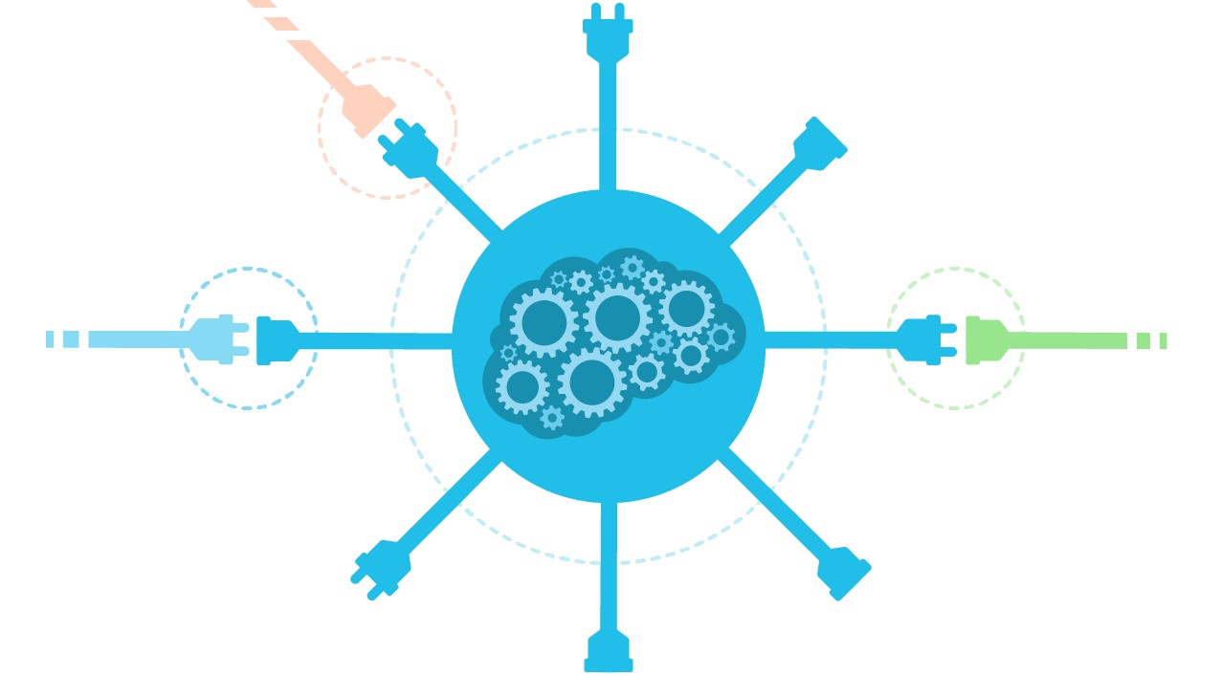


Testing efforts (headaches)
Conditional Rendering
Excessive, unsupported or unnecessary dependencies
Setting up APIs to transfer information between systems
Unexpected Obstacles

Slide 10
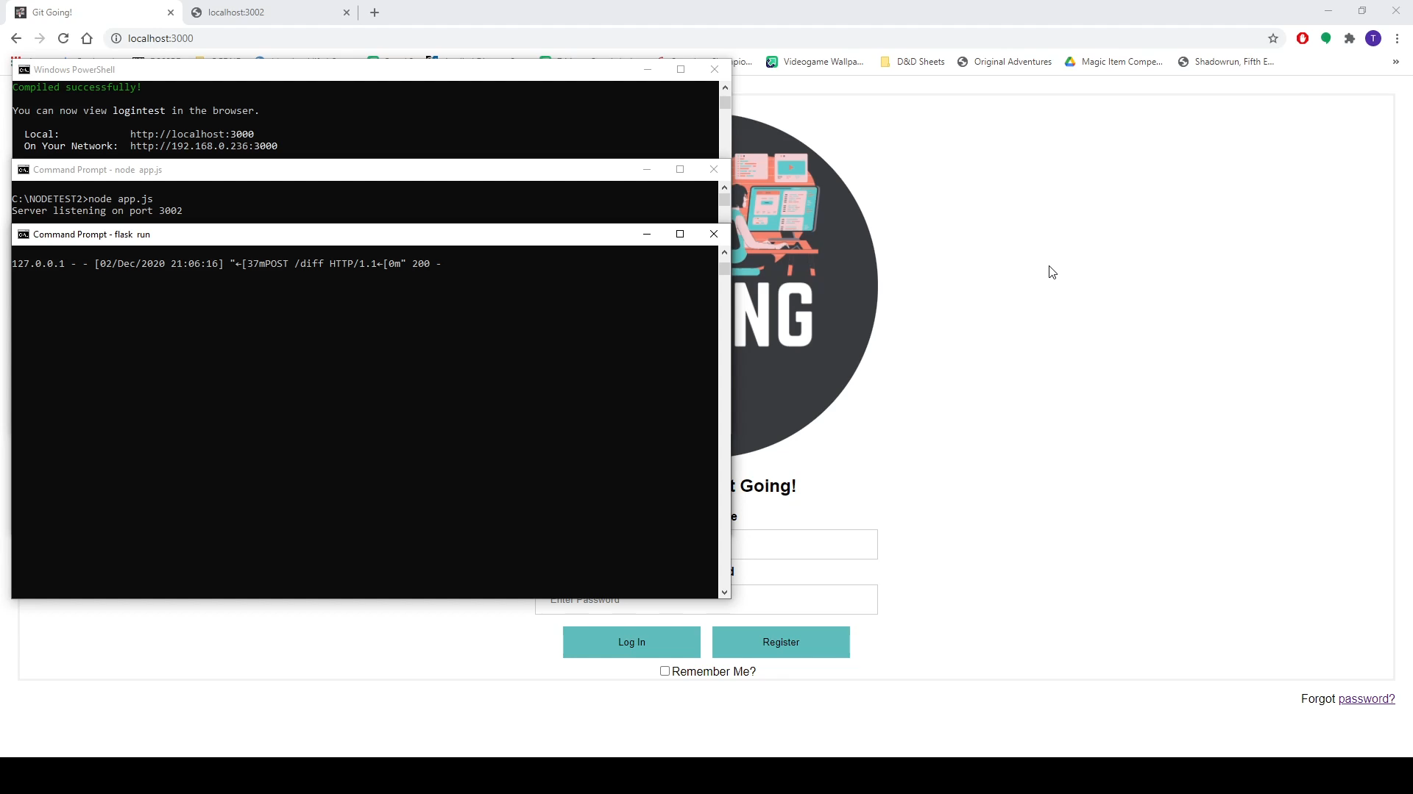
DEMO OF LOGIN FLOW AND CODE REVIEW A demonstration of the log-in flow and code review process in an extremely bare-boned setting. The usage of local Storage is a facsimile of a real authorization process without the API attached to it.
.

Slide 11

the road ahead
Integrate separated features
Hook log-in system up to authentication service
Rewrite DB API to handle secure retrieval of data
Introduce commenting system for reviews
Beautify systems in-place

